Slide 1
20XC15 -Problem Solving and C Programming
Control Statements in C

Slide 2
Outline
Control statements
Selection/Branching
  Conditional
    If
    If else
    Nested if-else
    else if ladder
  Unconditional
    go to
    break
    continue
    return
Iteration/Looping
    for
    while
    do – while

Slide 3

Control Statements
The C programs presented until now follows a sequential flow of execution of statements
  Statements in a program are normally executed one after another until the last statement completes
  A C application begins executing with the first line of the main() function and proceeds statement by statement until it gets to the end of the main() function
Compound Statement a group of statements bracketed by { and } that are executed sequentially

Slide 4
Control Statements
Transfer of Control / Flow of control
  The order in which statements are executed in a running program
Control statements / structures control the flow of execution in a program or function
The C control structures enable to combine individual instructions into a single logical unit with one entry point and one exit point

Slide 5
Control Statements
Instructions are organized into three kinds of control structures to control execution flow
  Sequence
  Selection, and
  Repetition
Sequential Programming
  Normally, statements in a program are executed one after the other in the order in which they’re written
  The most straightforward control structure
  A list of what to do, step by step
  Example
    Addition of two numbers

Slide 6
Control Statements
Selection in Programming
  Some problem solutions require steps with two or more alternative courses of action
  A selection control structure chooses which alternative to execute
  Often programmed using if statements (simple if, if-else, nested if and else if ladder), or switch-case statement
  Allow different sets of instructions to be executed depending on the outcome of a logical test ‒ Whether TRUE or FALSE - Branching
For example: To Pack my bag for work
  Pack my PC
  Pack my money
  If it's raining
    Pack my coat

Slide 7
Control Statements
Repetition in Programming: (Also called as Iteration)
  Some applications may also require that a set of instructions be executed repeatedly, possibly again based on some condition - Looping
  Typically programmed using code such as while, do-while and for statements
  Repetition Vs Selection statements
    In selection, the condition is tested once
    In repetition, the condition is tested a number of times, every time the program decides whether to loop or not

Slide 8
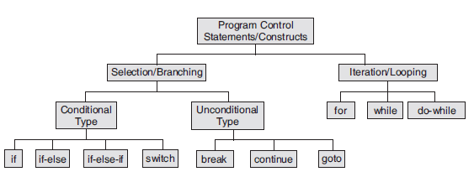
Control Statements in C

Slide 9
Conditional Branching
C provides three types of selection structures in the form of statements
  Single selection statement - if statement
    It selects or ignores a single action
  Two-way or double-selection statement - if…else statement
    It selects between two different actions
  Multi-way or Multiple-selection statement - else if ladder and switch statement

Slide 10

The if Selection Statement
Selection statements are used to choose among alternative courses of action.
For example
  Suppose the passing grade on an exam is 60.
The pseudocode statement determines whether the condition “student’s grade is greater than or equal to 60” is true or false.
If the condition is true, then “Passed” is printed, and the next pseudocode statement in order is “performed” (remember that pseudocode isn’t a real programming language).
If the condition is false, the printing is ignored, and the next pseudocode statement in order is performed.

Slide 11
The if Selection Statement
The general form of the if statement
if (condition/expression)
statement;
if (condition/expression)
{
statement sequence;
}
if - keyword
expression - constant or variable or relational or arithmetic or logical expression. Expression evaluates to TRUE(1) or FALSE (0)
statement - may either be a single statement or a block of statements
If expression is true (nonzero), statement is executed. If expression is false, statement is ignored
Note:
If a block contains a single statement, the braces can be deleted

Slide 12
How do we specify the expressions/conditions?
Using relational operators
  Four relation operators: <=, >, <, >=
  Two equality operators: ==, !=
Using logical operators / connectives
  Two logical connectives: &&, | |
  Unary negation operator: !
The conditions evaluate to
  Zero ‒ Indicates FALSE
  Non-zero ‒ Indicates TRUE
  Typically the condition TRUE is
  represented by the value 1
Examples
  count <= 100
  (math+phys+chem)/3 >= 60
  (sex==’M’) && (age>=21)
  (marks>=80) && (marks <90)
  (balance>5000)|| (no_of_trans>25)
  !(grade==‘A’)
  !((x>20) && (y<16))

Slide 13
Confusing Equality (==) and Assignment (=) Operators
Dangerous error
  Does not ordinarily cause syntax errors
  Any expression that produces a value can be used in control structures
  Nonzero values are true, zero values are false
  Example
  if (payCode = = 4)
  printf(ʺYou get a bonus!\nʺ);
  if (payCode = 4)
  printf(ʺYou get a bonus!\nʺ);

Slide 14
Examples
if (10<20)
{ a = b + c;
printf (ʺ%dʺ, a);
}
if ((a>b) && (x=10)) { …….… }
if (1) { ……………… }
if (0) { ……………… }
if (-1) {………………..}
if (a+b) {………………}

Slide 15
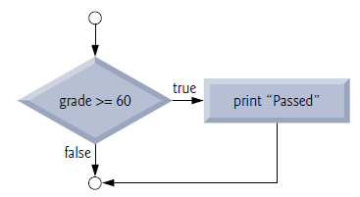
The if Selection Statement
The preceding pseudocode If statement may be written in C as
if ( grade >= 60 )
puts( "Passed" );
if ( grade >= 60 ) {
puts( "Passed" );
} // end if
The second line of this selection statement is indented. Such indentation is optional, but it’s highly recommended, as it helps emphasize the inherent structure of structured programs

Slide 16
The if Selection Statement
Note : Never place a semicolon after an expression in an if statement
#include<stdio.h>
int main() {
int grade=50;
if(grade>=60) ;
puts(“Pass");
}
In-class Exercise
  Write a program that will ask for a price. If the price is greater than 1000, compute a 10% discount from the original price. Display the computed discount.
#include<stdio.h>
int main() {
int grade=50;
if(grade>=60)
puts(“Pass");
puts(“Congrats”);
}
#include<stdio.h>
int main() {
int grade=70;
if(grade>=60)
{ puts(“Pass");
puts(“\nCongrats”);
}
}
Output : Pass
Output : Congrats
Output : Pass
Congrats

Slide 17
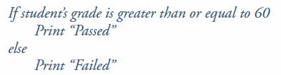
The if…else Selection Statement
The if selection statement performs an indicated action only when the condition is true; otherwise the action is skipped.
The if…else selection statement allows you to specify that different actions are to be performed when the condition is true and when it’s false
For example, the pseudocode statement
Prints Passed if the student’s grade is greater than or equal to 60 and Failed if the student’s grade is less than 60. In either case, after printing occurs, the next pseudocode statement in sequence is “performed”

Slide 18

The if…else Selection Statement
The general form of if…else statement is
if (condition/expression)
statement_1;
else
statement_2;
If and else - keywords
expression - constant or variable or relational or arithmetic or logical expression. Expression evaluates to TRUE(1) or FALSE (0)
statement - may either be a single statement or a block of statements
If expression is true (nonzero), statement1/ statement_sequence1 is executed. If expression is false, statement 2 / statement_sequence1 is executed (else block)
if (condition/expression) {
statement_sequence1;
}
else {
statement_sequence 2;
}
Note: If a block contains a single statement, the braces can be deleted

Slide 19
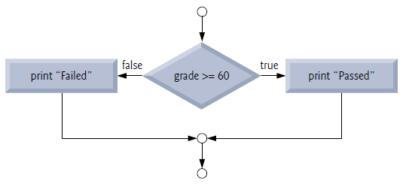
The if…else Selection Statement
The preceding pseudocode If…else statement may be written in C as
if ( grade >= 60 ) {
puts( "Passed" );
} // end if
else {
puts( "Failed" );
} // end else
if ( grade >= 60 )
puts( "Passed" );
else
puts( "Failed" );
Note:
Only the code associated with the if or the code that is associated with the else executes, never both

Slide 20
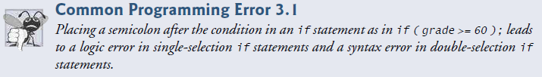
The if…else Selection Statement
Note: Never place a semicolon after an expression in an if…else statement
#include<stdio.h>
int main() {
int grade=66;
if ( grade >= 60 );
puts( "Passed" );
else
puts( "Failed" );
}
error: 'else' without a previous 'if'

Slide 21
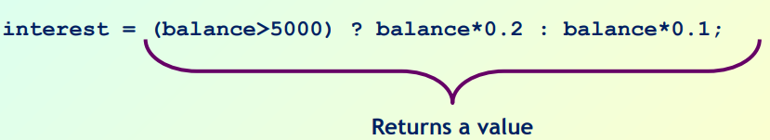
The if…else Selection Statement
C provides the conditional operator (?:), which is closely related to the if…else statement
The conditional operator is C’s only ternary operator—it takes three operands
These together with the conditional operator form a conditional expression.
condition ? Expression1 : Expression2;
The first operand is a condition. The second operand is the value for the entire conditional expression if the condition is true and the third operand is the value for the entire conditional expression if the condition is false
puts( grade >= 60 ? "Passed" : "Failed" );
grade >= 60 ? puts( "Passed" ) : puts( "Failed" );

Slide 22

The if…else Selection Statement
Conditional operators can be used in places where if…else statements cannot, including expressions and arguments to functions (like printf)
bool y = (x == 42) ? true : false;
bool y;
if (x == 42) {y = true;} else {y = false;}
int a = (b == 2) ? x1 : x2;
#include<stdio.h>
int main()
{ int b=10, c=20, a;
printf(“a =%d", a=(b>c) ? 100 : 200);
}

Slide 23
Nested if-else Statement
If-else statement containing another if-else statement is known as nested if-else statement
The statement may be nested as deeply as you need to nest it
Syntax 1
Syntax 2
if(condition1/expression1)
if(condition2/expression2)
statement1;
else
statement2;
else
if(condition3/expression3)
statement3;
else
statement4;
if(condition1/expression1)
if(condition2/expression2)
statement1;
else
statement2;
else
statement3;

Slide 24
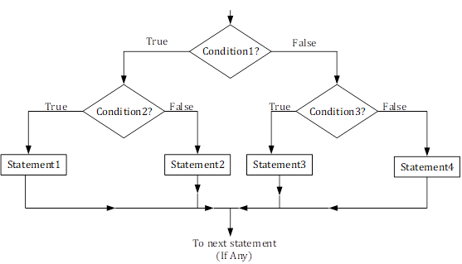
Nested if-else Statement

Slide 25
Nested if-else Statement
Nested if is difficult to understand if there are more than 3 alternatives
Example
In a competitive exam a student getting more than 90 in Grade 1 exam only can appear in Grade 2 exam. Otherwise he has to redo it. If he gets more than 90 in Grade 2, then only he is allowed to write Grade 3 exam. If he clears Grade 3 exam he is declared pass. If he does not clear Grade 3 he has to redo Grade 3 exam

Slide 26
Nested if-else Statement
#include <stdio.h>
int main ()
{ int grade1,grade2,grade3;
printf ("Enter Grade 1 marks\n");
scanf ("%d ", &grade1);
if (grade1 > 90)
{ printf ("Enter Grade 2 marks\n");
scanf ("%d ", &grade2);
if (grade2 > 90)
{ printf ("Enter Grade 3 marks\n");
scanf ("%d ", &grade3);
if (grade3 > 90)
printf(“Performed well in Grade 3 too”);
else
printf(“Redo Grade 3”);
}
else
printf(“Redo Grade 2”);
}
else
printf (" Redo Grade 1");
}

Slide 27
Nested if...else Statements
Nested if…else statements test for multiple cases by placing if…else statements inside if…else statements
ie., It is possible to nest if-else statements, one within another
For example
The following pseudocode statement will print
  A for exam grades greater than or equal to 90
  B for grades greater than or equal to 80 (but less than 90)
  C for grades greater than or equal to 70 (but less than 80)
  D for grades greater than or equal to 60 (but less than 70) and
  F for all other grades

Slide 28
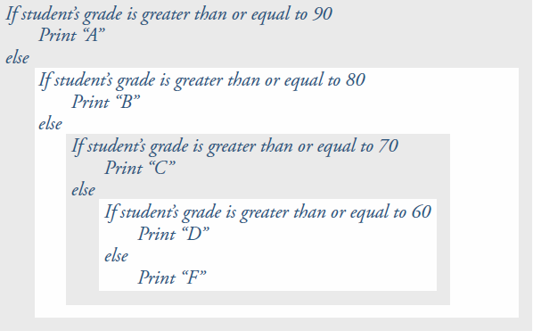
Nested if...else Statements

Slide 29
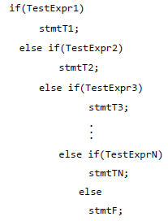
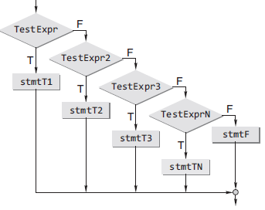
else-if ladder Statements
General form

Slide 30
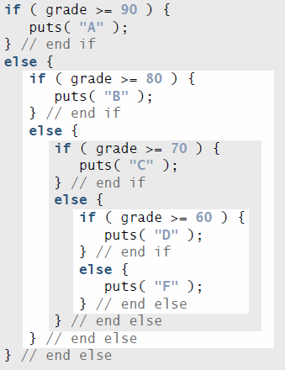
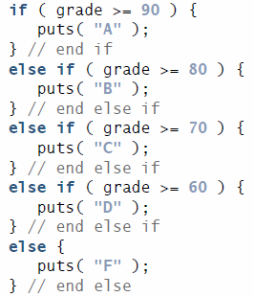
else-if ladder Statements
This pseudocode may be written in C as

Slide 31

Problems and Solutions in
Nested if...else Statements
It is possible to nest if-else statements, one within another
All if statements may not be having the “else” part
Confusion??
Rule to be remembered
  An “else” clause is associated with the closest preceding unmatched “if”

Slide 32
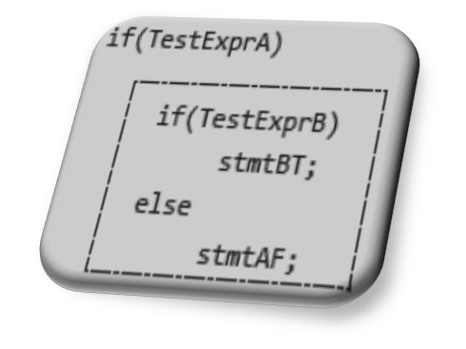
Dangling else Problem
This classic problem occurs when there is no matching else for each if. To avoid this problem, the simple C rule is that always pair an else to the most recent unpaired if in the current block
Consider the illustration shown here
The else is automatically paired with the closest if. But, it may be needed to associate an else with the outer if also

Slide 33
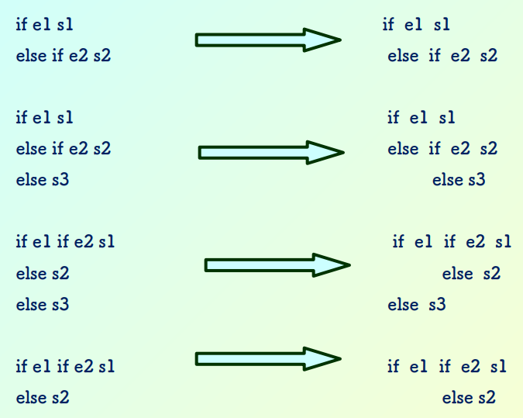
Nested if...else Statements

Slide 34
Problems and Solutions in
Nested if...else Statements
Dangling else problem
  When nested ifs are used, the problem of dangling else should be addressed
  For example, consider
    If (testscore >=50)
    if (testscore >90)
    printf (“You got an A Grade”);
    else
    printf(“fail”);
Indentation imply else is meant to be paired with outer if, but it pairs with inner if

Slide 35
Problems and Solutions in
Nested if...else Statements
Solution to Dangling Else
  Enclose inner if by braces as shown in order to avoid dangling else
    If (testscore >=50) {
    if (testscore >90)
    printf (“You got an A Grade”);
    else
    printf(“test score is between 50 to 90”);
    }
    else
    printf(“fail”);
It is safer to enclose the statement(s) within if block by braces to avoid dangling else

Slide 36
Problems and Solutions in
Nested if...else Statements
if e1 s1 if e1 s1
else if e2 s2 else { if e2 s2 }
if e1 s1 if e1 s1
else if e2 s2 else { if e2 s2
else s3 else s3 }
if e1 if e2 s1 if e1 { if e2 s1
else s2 else s2 }
else s3 else s3

Slide 37
Problems and Solutions in
Nested if...else Statements
Avoiding the dangling else problem
Null statement
if (exp1)
if (exp2)
stmta
else
;
else
stmtb
Compound statement
if (exp1) {
if (exp2)
stmta
}
else
stmtb

Slide 38
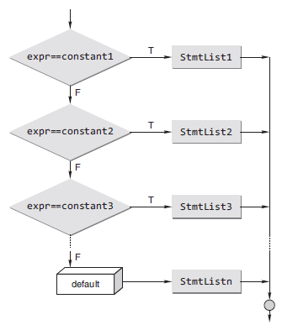
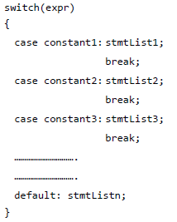
The switch Statement
C provides the switch multiple-selection statement to handle decision making
Syntax

Slide 39
The switch Statement
/* Determine life expectancy of a standard light bulb */
#include <stdio.h>
int main()
{ int watts;
scanf(“%d”, &watts);
switch (watts) {
case 25:
life = 2500;
break;
case 40:
case 60:
life = 1000;
break;
case 75:
case 100:
life = 750;
break;
default:
life = 0;
} }
/* Determine whether a given number is odd or even
#include <stdio.h>
int main()
{
int n;
printf(“\n Enter the number:”);
scanf(“%d”, &n);
switch(n%2)
{
case 0: printf(“\n EVEN”);
break;
case 1: printf(“\n ODD”);
break;
}
}

Slide 40
The switch Statement
switch, case, break and default - Keywords
switch is followed by an expression in parentheses - controlling expression
The value of this expression is compared with each of the case labels
The switch statement is different from all other control statements in that braces are not required around multiple actions in a case of a switch
In switch statement, each individual case can test only a constant integral expression
  i.e., any combination of character constants and integer constants that evaluates to a constant integer value

Slide 41
The switch Statement
The switch-case selection statement has the switch statement with an expression and number of case definitions with their constants.
Only integer and single character constants can be used as case constants
Execution starts from the case whose constant matches with the value of switch expression
If the value of switch expression doesn’t match with any of the case constants then the default case is executed
break - statement is used to execute only a single case out of the total structure
Defining the default case in switch-case control structure is optional

Slide 42
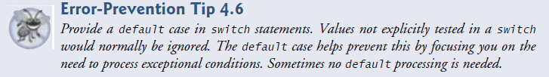


The switch Statement

Slide 43
The switch Statement
Rules for switch statement
The expression provided in the switch should result in a constant value otherwise it would not be valid.
  Expression in switch must be integral (integer or character) expression or variable or constants, floating point values are not allowed
Values for 'case' must be integer or character constants, not floating point constant, you cannot use ranges in case
The order of the 'case' statements is unimportant, the default clause may occur any where (convention places it last)
If no break statement, the subsequent cases following the true case are also executed
No two case labels can have the same value
Two case labels can be associated with same statement
A switch statement can be nested. In such cases, case or default labels associate with the closest switch statement that encloses them
A switch…case statement can be always written using else if. But the converse is not true

Slide 44
The switch Statement
#include<stdio.h>
int main()
{
int value1, value2;
char operator;
printf(“Type in your expression. \n”);
scanf(“%d %c %d ”,&value1,&operator,&value2);
switch(operator)
{
case ‘+’:
printf(“%d \n”, value1 + value2);
break;
case ‘-’:
printf(“%d \n”, value1 - value2);
break;
case ‘*’:
printf(“%d \n”, value1 * value2);
break;
case ‘/’:
if(value2 == 0)
printf(“division by zero”);
else
printf(“%d \n”, value1 / value2);
break;
default:
printf(“Unknown Operator \n”);
break;
}
return 0;
}

Slide 45
The switch Statement
#include <stdio.h>
int main()
{
char c;
printf(“Enter a character: “);
scanf(“%c”, &c);
switch(c)
{
case ‘a’:
case ‘A’:
case ‘e’:
case ‘E’:
case ‘i’:
case ‘I’:
case ‘o’:
case ‘O’:
case ‘u’:
case ‘U’:
printf(“%c is always a vowel!\n”, c);
break;
case ‘y’:
case ‘Y’:
printf(“%c is sometimes a vowel!\n”, c);
break;
default:
printf(“%c is not a vowel!\n”, c);
break;
}
return 0;
}

Slide 46
Switch Vs else if Statements
The switch differs from the else-if in that switch can test only for equality, whereas the if conditional expression can be of a test expression involving any type of relational operators and/or logical operators. A switch statement is usually more efficient than nested ifs
The switch statement can always be replaced with a series of else-if statements. One may only use switch and case statements if an expression is required to check against a finite amount of constant, integral, or character values

